Slide 1
Programming Fundamentals
Lecture 22

Slide 2
Objectives
Local Variables
Global Variables
Static Variables
Returning 1D array from functions

Slide 3
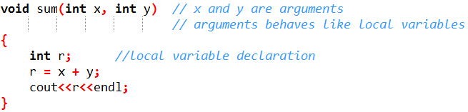
Local Variables
Variables that are declared inside a function or block are local variables
They can be used only by statements that are inside that function or block of code
Local variables are not known to functions outside their own
Local variables of a function are destroyed after the execution of that particular function

Slide 4
Global Variables
Global variables are defined outside of all the functions, usually on top of the program
The global variables will hold their value throughout the life-time of the program
A global variable can be accessed by any function. That is, a global variable is available for use throughout the entire program after its declaration

Slide 5
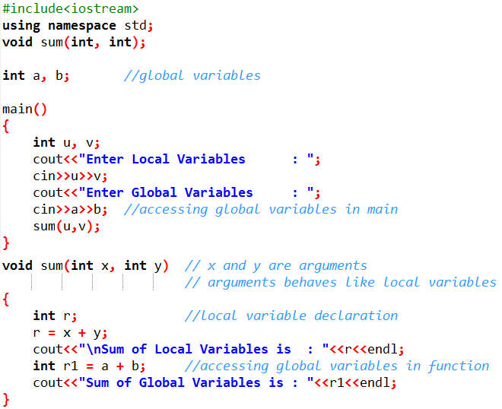
Global Variables (Example)

Slide 6
Initial Values of Local & Global Variables
When a local variable is declared, it is not initialized by the system, you must initialize it yourself
Global variables are initialized automatically by the system when you declare them as follows:
Data Type | Initial Value
int | 0
float | 0
double | 0
char | ‘\0’
pointer | NULL

Slide 7
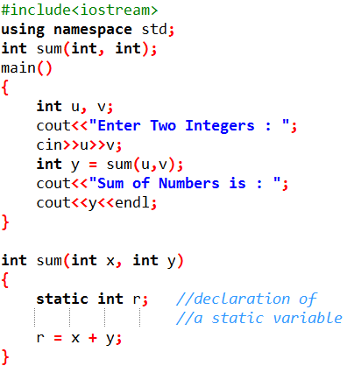
Static Variable
As you now know that the local variables of a function are destroyed upon the exit of that particular function
If we want to retain the information from a function even after its execution we use the static variables
Static variable can be declared by using the keyword “static”
Have a look at the following example

Slide 8
Returning Arrays from Functions
C++ does not allow to return an entire array from a function
However, we can return a pointer to an array by specifying the array's name without an index
If we want to return a single-dimension array from a function, we would have to declare a function returning a pointer
int *function()
{ }
Second point to remember is that C++ does not advocate to return the address of a local variable to outside of the function so we would have to define the local variable as static variable

Slide 9
Practice Problem 1
Write a program to generate 10 random numbers and return them in the form of an array

Slide 10
Random Number Generation
cstdlib header line contains the built-in function for random number generation
The function rand() is used to generate the random numbers
To confine the generated numbers in a specific range we can use modulus operator
To make sure that the number are different at each execution we use srand(time(0)) command
The above function will be used with time.h header file

Slide 11
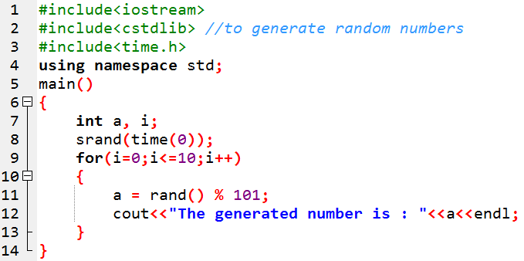
Random Number Generation
The following code will generate 11 random number between 0-100. And at each execution the numbers will be different

Slide 12
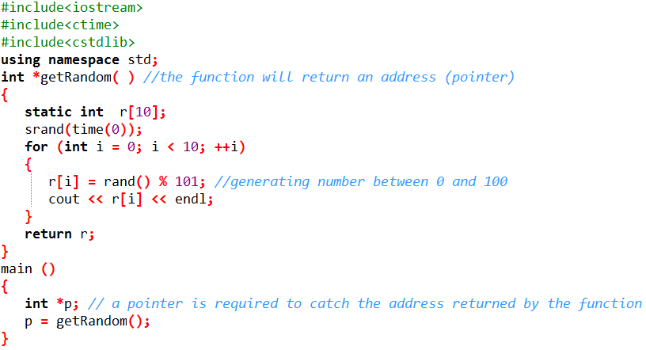
Practice Problem 1
Write a program to generate 10 random numbers and return them in the form of an array

Slide 13
Practice Problem 2
Modify the code provided for practice problem 1 to add 10 in each randomly generated number and display the number before and after adding 10. (DO NOT change the definition of function)
Generated Numbers are:
10 15 4 9 8 45 78 18 82
Number after adding 10 are:
15 20 25 14 19 18 55 88 28 92
Done in Class, Have a look at your lecture notes

